Slide 1

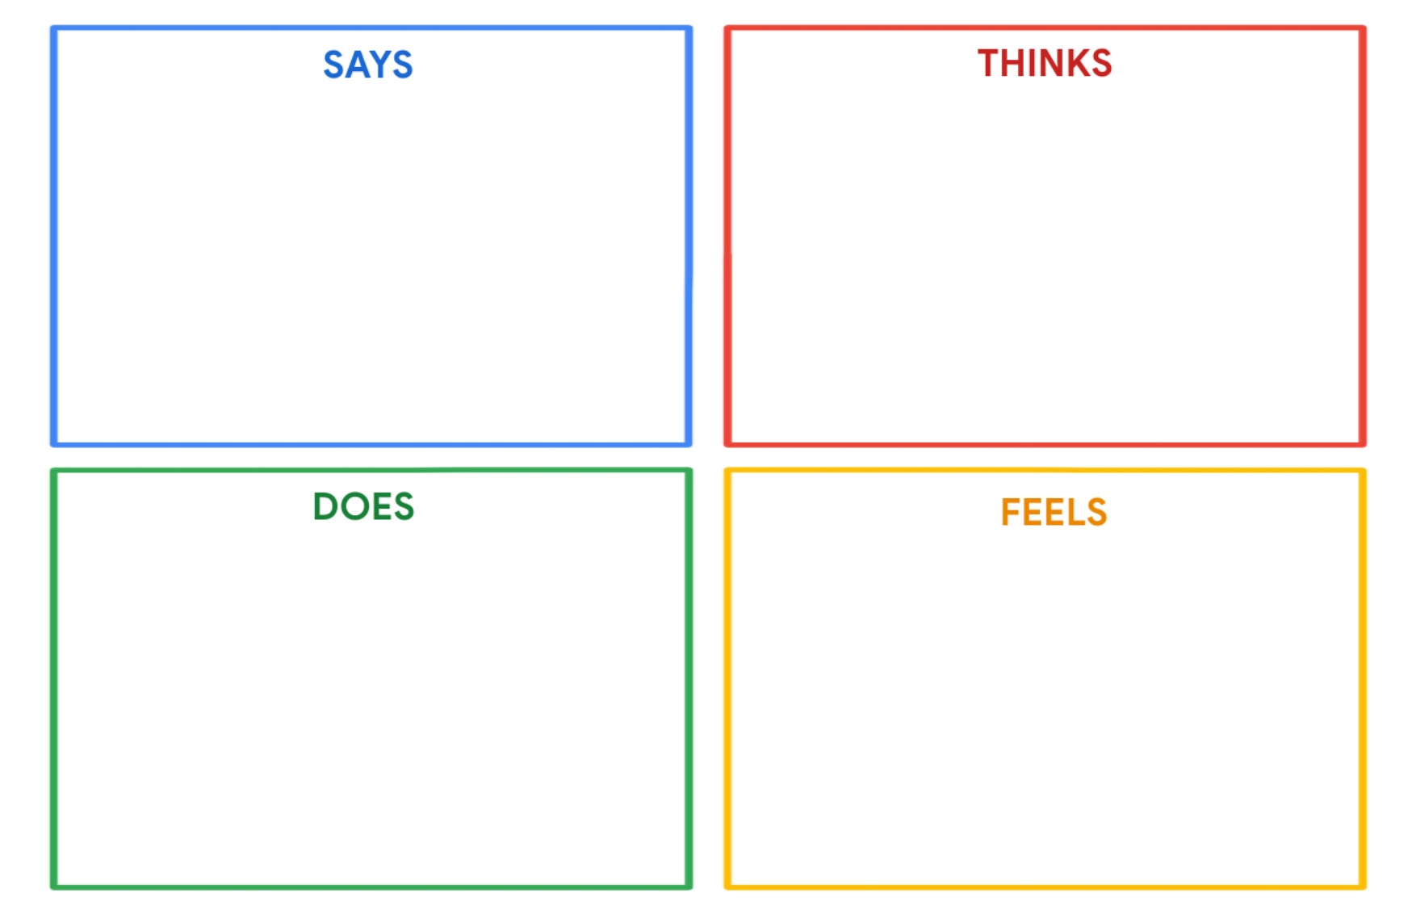
Sarah Taha
"I want to empower my kids with programming skills for their future."
"Spending quality time with my family "
"I enjoy reading and cooking "
"I value education and encourage my children to learn and grow."
"Balancing life, parenting, and education can be challenging."
"How can I best support and encourage my children's programming education?"
"I find relaxation and joy in reading, gardening, and cooking with my kids."
"Education is a lifelong journey, and I want my children to embrace it."
"Managing time and resources efficiently"
Sarah actively supports her children's programming education
She spends time reading, gardening, and cooking with her kids
Sarah encourages a love for learning and growth in her children.
She works on balancing her responsibilities as a parent, homemaker, and supporter of her children's education
Sarah is passionate about empowering her children with programming skills.
Quality family time brings her joy and fulfillment.
Gardening, cooking, and outdoor nature walks create a sense of relaxation and togetherness.
She feels a strong commitment to her children's education and personal growth.

